Slide 1

Ejecting a Pallet
6.25.24 version 1.0

Slide 2
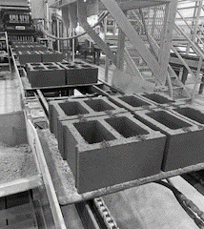
Assumptions and Prerequisite Skills
none
Supplies Needed
Standard PPE

Slide 3
Preface
A pallet should be ejected when more than one block does not meet quality specs. If the outcome of this pallet was not expected, assess future cycles. If you have three poor quality pallets in a row, see “Bad Pallet Troubleshooting” to find the cause of the bad pallet.

Slide 4
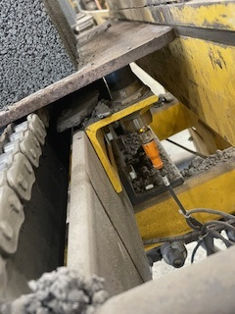
1. Before turning the “Material Ejector” position to auto. Make sure any good pallets in front pass the pallet ejector probe. You can tell this through the light on the bottom of the probe that indicates when something is above it (Blue circle in Figure 1).
Figure 1

Slide 5
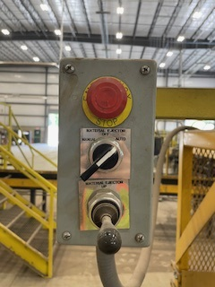
2. At this point you may now turn the “Material Ejector” switch to the “auto” position (Green circle in Figure 2).
3. Once you have ejected any pallets that needed ejection, turn the “Material Ejector” switch back to the “off” position.
Figure 2

